Slide 1
Discussion Unit: DSE Analytics, Persistence
Understand the role of persistence when using DSE Analytics
Notes:
The goal of this Discussion Unit is to gain an understanding of the role of "persistence" when using DSE Analytics.

Slide 2
Discussion Lab:
DSE Analytics; Optimization (thus far)
Discuss-
Notes:
On the next page we enter a Discussion Lab.

Slide 3

DSE Analytics: Optimization (thus far) ..
Based on what you know right now; How can you make your Spark Job faster, more efficient ?
Source: https://www.amazon.com/gp/product/0060929510
Notes:
Discuss-
Based on what you know right now; How can you make your Spark Job faster, more efficient ?

Slide 4
End of Discussion Lab:
Notes:
End of Discussion Lab-

Slide 5
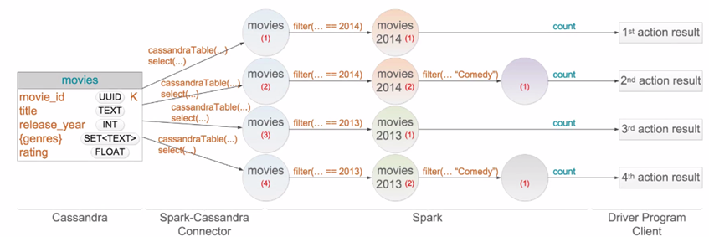
Why we persist- (And recovery from failure)
Image From: DSA-320
Notes:
Examine the work done in this DAG-
Do you see and redundancy ?

Slide 6
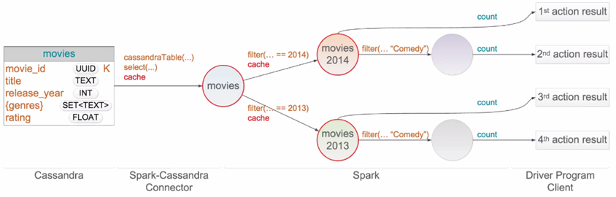
Why we persist- (And recovery from failure)
Image From: DSA-320
Notes:
Everything you know about why we persist can be introduced on the one graphic above-
Reduce redundant processing (savings of resources)
Faster recovery from failure
Lazy evaluation

Slide 7
RDD/DataFrame/DataSet: Persistence API-
Transform
Description
Persists source RDD According to storage level (sl) specified. Default is MEMORY_ONLY, which persists RDD element as deserialized Java objects in the JVM.
persist(sl)
cache()
Same as persist(StorgageLevel.MEMORY_ONLY)
unpersist()
Optional; Spark automatically manages this.
Notes:
We persist when:
There is an existing call to recompute the same RDD multiple times
There is a need to re-use an RDD at a later time

Slide 8
Storage Levels
Storage Level
Description
MEMORY_ONLY
MEMORY_ONLY_SER
Deserialized, or Serialized, Java objects in the JVM. Partitions that do not fit are not stored, and are recalculated
MEMORY_AND_DISK
MEMORY_AND_DISK_SER
Same as above; partitions not fitting in memory are stored to disk
DISK_ONLY
Persisting to disk only.
MEMORY_ONLY_2
MEMORY_AND_DISK_2
Same as above; replication to two nodes
OFF_HEAP
Serialized in-memory using Tachyon; a memory-centric distributed storage system
** Serialized: more space efficient, more CPU intensive
Notes:
Realted to these settings and use:
Call the persist() method before the first action
Persist is not an action, so it does not force evaluation
Spark will evict old partitions using a least recently used (LRU) policy
unpersist() to manually remove from cache. I.e., if pulling user data from DSE and calculating average age, then again on same data set calculate number in each state.

Slide 9

Example: When to apply
val c_rows = sc.cassandraTable("ks_7571", "customer").
select("customer_num", "state").
as((customer_num:Int, state:String) =>
(customer_num, (state)))
val o_rows = sc.cassandraTable("ks_7571", "orders").
select("customer_num", "order_num", "paid_date").
as((customer_num:Int, order_num:Int,
paid_date:String) => (customer_num,
(order_num, paid_date)))
val j_rows1 = o_rows.join(c_rows)
val j_rows2 = o_rows.leftOuterJoin(c_rows).
filter{case (pk, (row_o, row_c)) => row_c.isDefined}
val j_rows3 = o_rows.leftOuterJoin(c_rows).
filter{case (pk, (row_o, row_c)) => row_c.isDefined}.
map{r => ( r._1, Option(r._2._1._2), r._2._1._1, r._2._2 )}.
map{r => ( r._1, r._2.getOrElse("N/A"), r._3, r._4.get )}
j_rows4.saveToCassandra("ks_7571", "customer_orders",
SomeColumns("customer_num", "paid_date",
"order_num", "state"))
A
B
Persist ? What level ?
C
D
Outer, and isDefined ?
E
F
Notes:
Given an example DAG above; when should persist be applied, and with what level ?

Slide 10
End of Unit:
Notes:
End of Discussion Unit-

